Slide 1
Valerie
Amy Winehouse

Slide 2
Amy Winehouse
London
Born 14 September 1983
Died 23 July 2011
Back to black ,Rehab, You know I’m no good,…
Jazz, soul
Some intresting facts
She had a drug and alcohol addiction
The song Valerie is a cover from the band The Zutons
She was the first British singer who won 5 Grammy awards

Slide 3
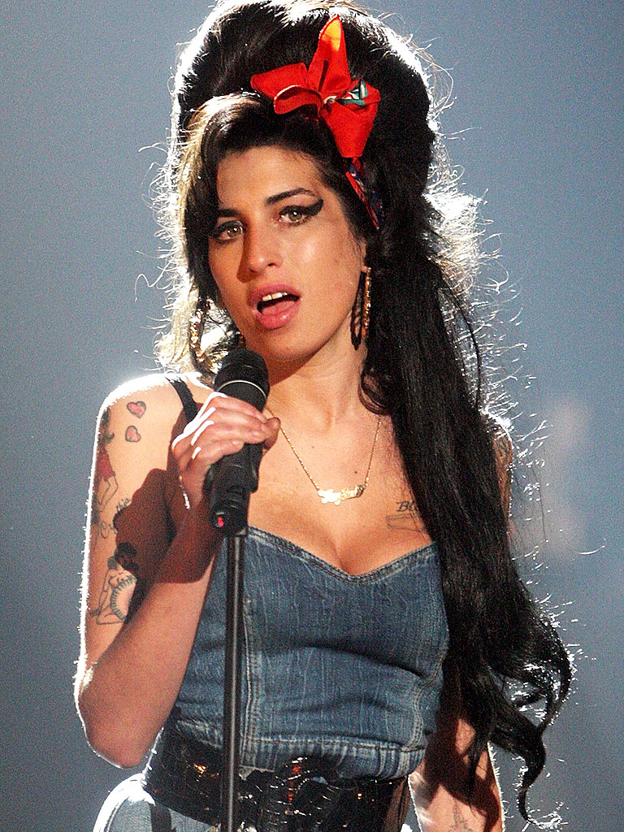

Slide 4
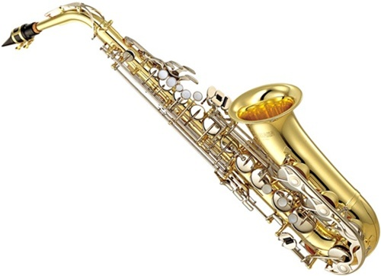
instruments
Alto sax

Slide 5
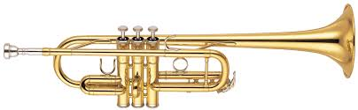
instruments
Trumpet

Slide 6
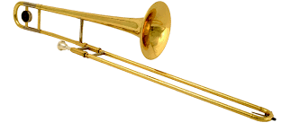
instruments
Trombone

Slide 7
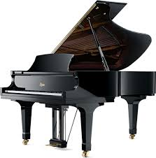
instruments
Piano

Slide 8
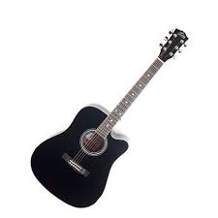
instruments
Guitar

Slide 9
3 difficult words
dodging = ontwijken
-verb
- You were dodging that kid with your car.
Fool = dwaas
- noun
- You are a fool.
Tan = bruinen
-verb
- Hope you catch a tan.

Slide 10
Why is this one of my favourite songs?
One of my favourite songs.
Memory
Little kid
Amy Winhouse
Makes me smile.

Slide 11
https://www.youtube.com/watch?v=ErIj1G8H61k&list=RDErIj1G8H61k#t=8

